Slide 1
Rainwater Management On Solebury Campus
SEAC
April 6, 2022

Slide 2
SEAC Members 2021-2022
Co-presidents:
Leel Dias
Aline Lu
Faculty Advisor:
Diane Downs
Members:
Sami Cavallone Mackenzie Perez
Vivian Chen Carlo Pinilla
Max Frankel Tiyasha Sarkar
Annalise Houghton Ede Shepard
Yahya Ozair Amelia Watson

Slide 3
Sustainability Vision Statement:
Solebury School's vision is to actively educate and engage students, faculty, staff, and the wider community in becoming good stewards of the environment while working to use resources efficiently, support a healthy ecosystem, and develop sustainable community practices.
Notes:
Back up words with actions
LD

Slide 4
The Problem
Much of the Solebury Campus sits in a flood plain
FEMA has expanded the area of the 100 year flood zone
Climate scientists predict that we will experience more and more serious storms and flooding events.
Significant financial costs, demands on time and labor, and temporary loss of spaces due to flooding

Slide 5
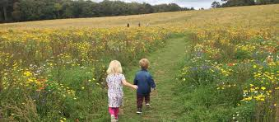
As a community, we need to rethink our relationship with the natural environment
and manage our campus in a more environmentally sustainable way.

Slide 6
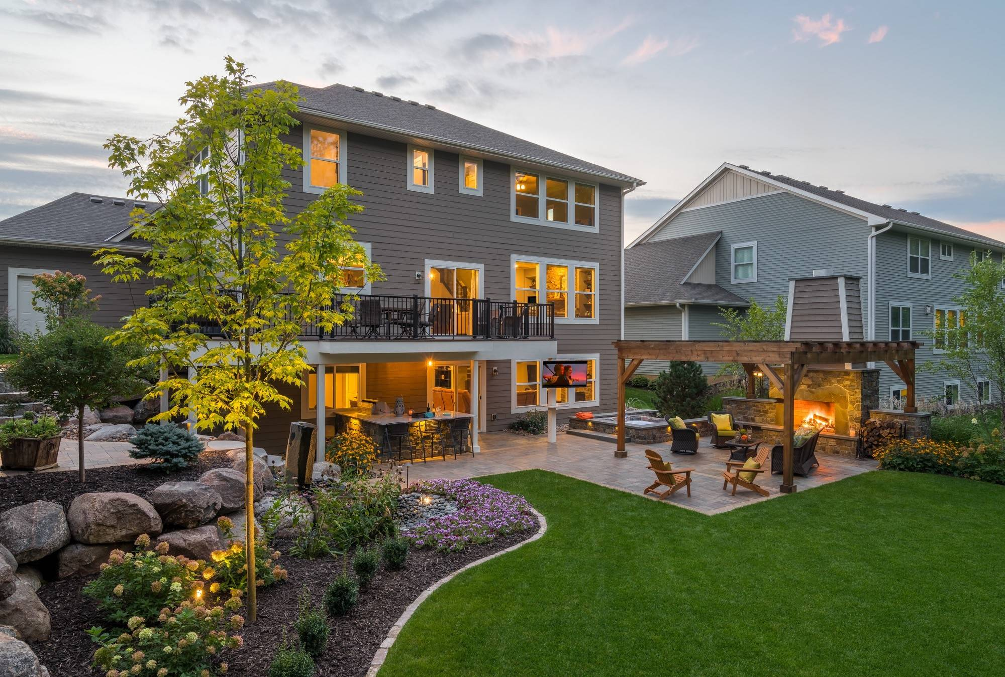
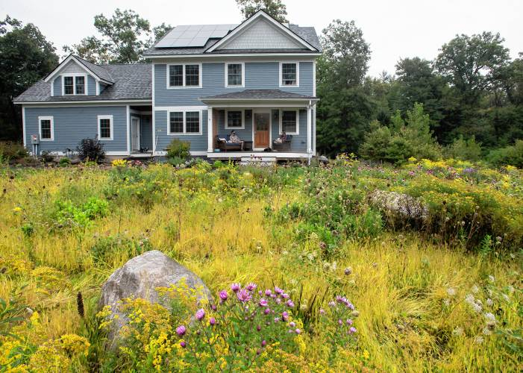
Rethink your image of a beautiful garden
Don’t tame nature, support it

Slide 7
Some Solutions
There are several things that we can do relatively easily to improve the health of our environment and also reduce the likelihood that our school will be negatively impacted by flood events in the future.
In areas that we mow, cut the grass to a higher length
Convert more mowed area to native plant meadows - planned for spring per Jim W.
Plant more native trees on campus and expand the woods in rarely used areas
Plant a riparian buffer along the Primrose Creek
Install rain gardens in areas that experience significant rain water run-off
Educate the community about why we are doing this and why they should as well
Notes:
Jim Wertman has already planned number 2. Riparian buffer will help reduce lake holmquist - We can combine 3 and 4 if you want - say:Plant more native trees including a riparian buffer along Primrose Creek
Higher mowing is a maintenance issue
Jim already has plants to convert to plant meadows - right - I think we say this in our presentation. We can quickly tick through the first two or three solutions

Slide 8
#1: Mow Higher
Mowing lawns short damages roots and soil.
The higher the grass, the longer and stronger the roots. This helps the grass conserve excess rainwater, avoid bug damage, and crowd out weeds.
Mowing higher and less often uses fewer resources.
Notes:
Source

Slide 9
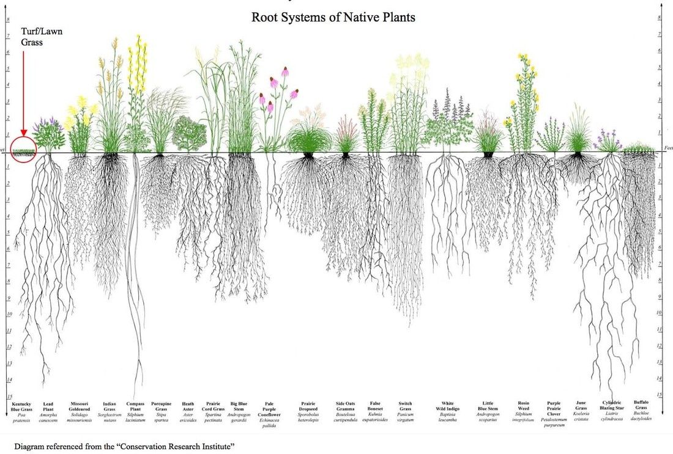

Slide 10
#2: Mow Less Area - Convert to Meadow
Much of our mown lawns are rarely used, and mowing requires significant manpower, time, gas, and maintenance of equipment
Lawns are a monoculture; plant diversity is better for the environment
Meadows require less water, fertilizer, and maintenance
Improved water infiltration, which slows rainwater run-off and increases drought tolerance
Increased carbon sequestration
Habitat for pollinators (many of which are endangered)
Food for songbirds and wildlife
Notes:
Warm season grasses have much deeper roots - main work horses of meadow - bloom later in season - need to rogue woody plants - can be mechanical and chemical - can do one mow a year in late winter in body of meadow and a burn every 5 years. - perimeter areas might be mowed twice to keep tidier - wet sections might need to be weed whipped

Slide 11
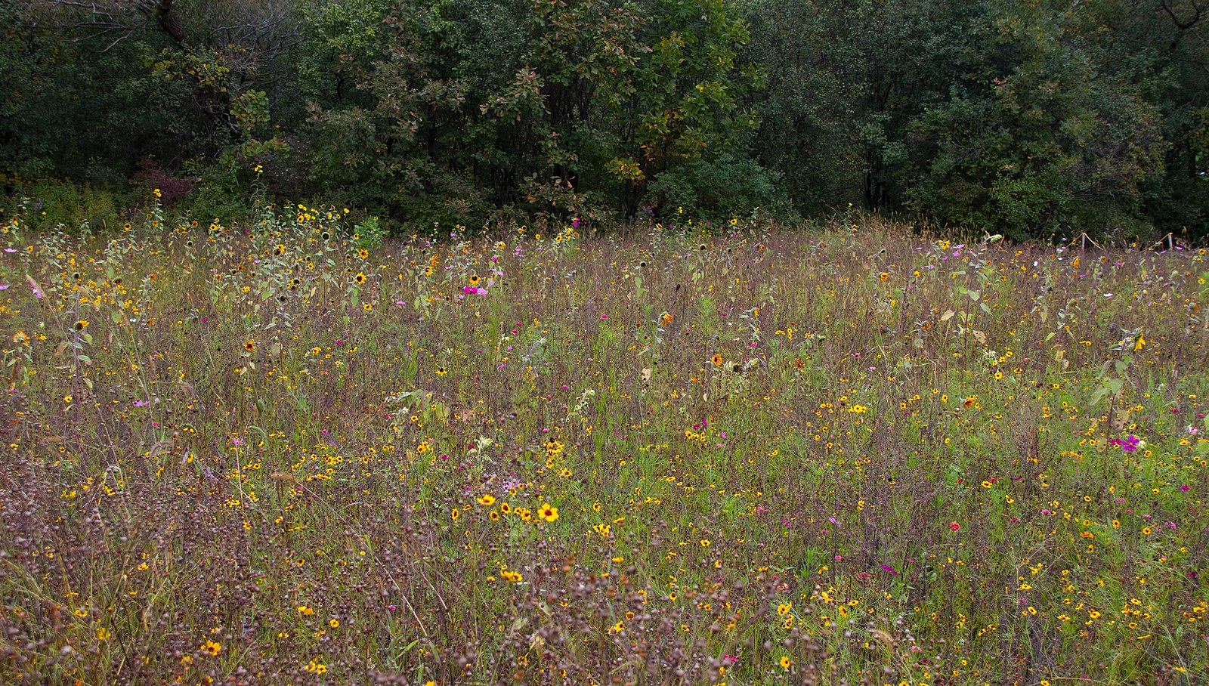

Slide 12
#3: Expand our wooded area - plant more trees
Prevents soil erosion and slows floodwaters
Reducing flooding
Sequesters carbon dioxide
Cleans the air
Acts as filter for water
Recharges groundwater
Cools the air and water
Provides wind breaks
Supports the lives of many organisms/species - both large and small

Slide 13
#4: Riparian Buffer:
Plant trees and shrubs along the Primrose Creek
Benefits
Absorbs rainwater
Filters run-off- improves water quality
Stabilizes eroding banks
Provides shade, shelter and food for aquatic life
Cool water holds more dissolved oxygen, which is breathed by fish and plants to help them survive.
Notes:
Minimum buffer width for stream bed stabilization, erosion control, stream shading is 20-30 feet (up to 100 ft) - Minimum of 50 feet is needed to filter pesticides, nutrients.
ONE WAY TO PLANT IS TO LIVE STAKE!

Slide 14
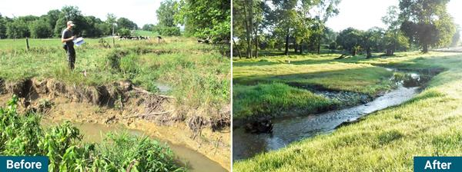
Before and after streambank restoration

Slide 15
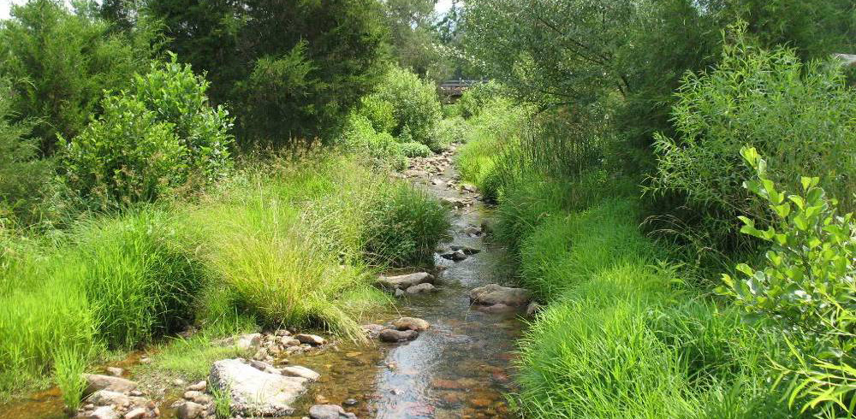

Slide 16
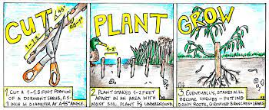
A Word about Livestaking
Benefits:
can be harvested off our property (or yours) for free
prevents soil loss
grows quickly
Notes:
Mini groves of trees - some livestakes nearby

Slide 17
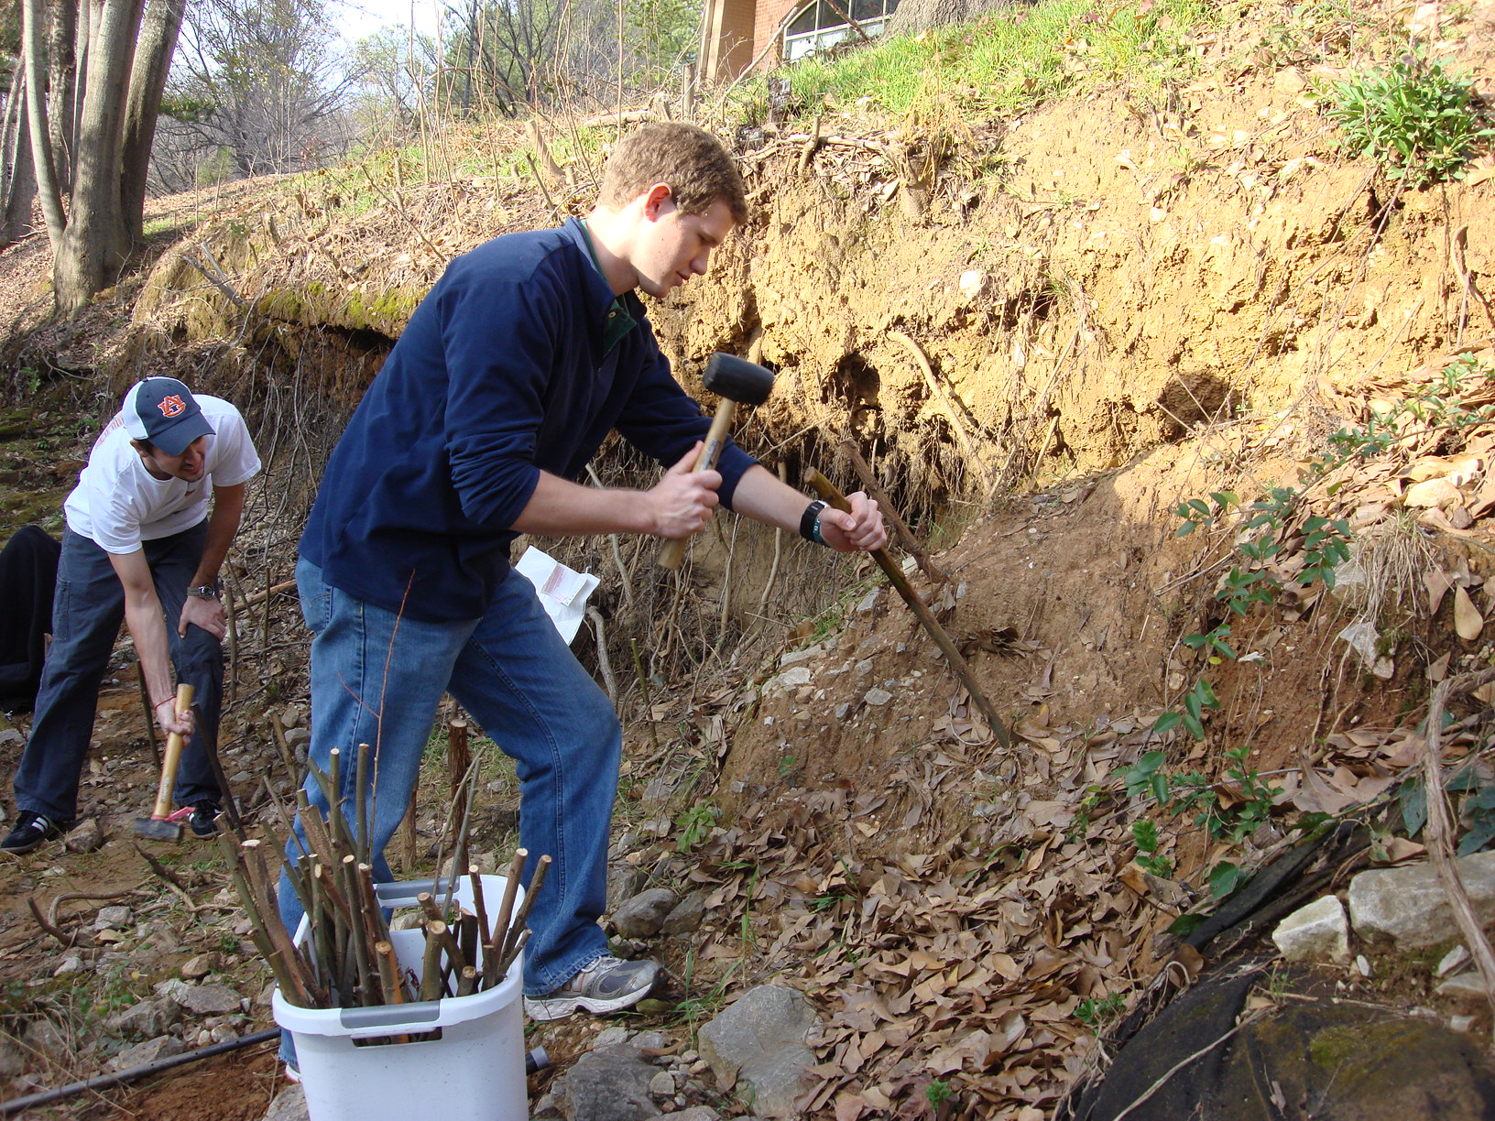
Volunteers livestaking along a stream bank

Slide 18
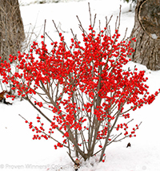
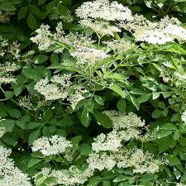
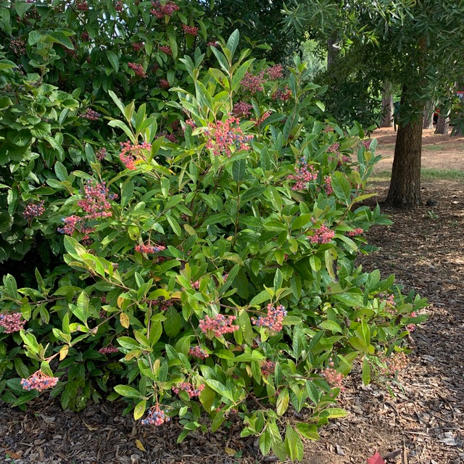
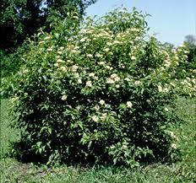
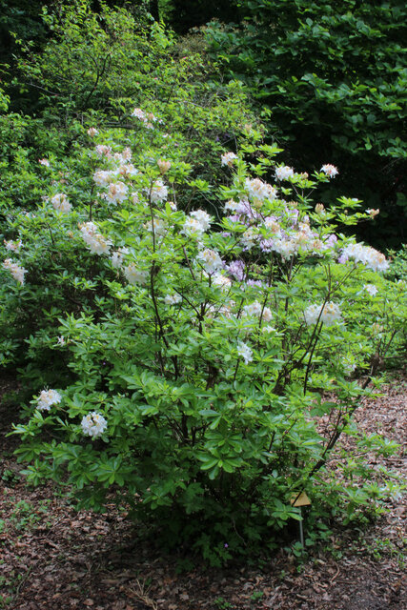
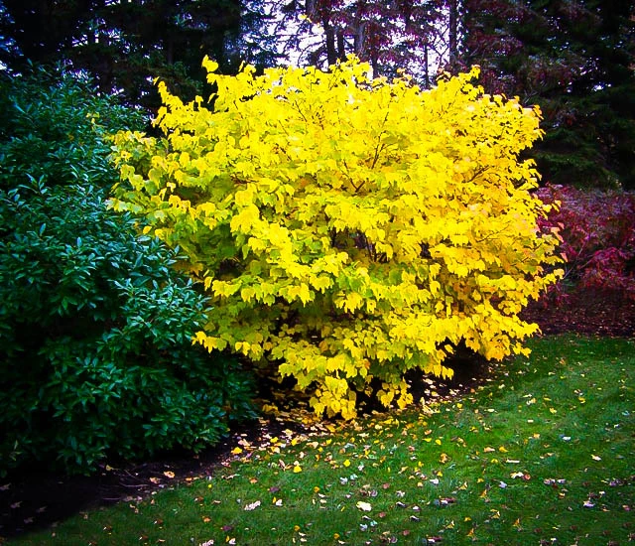
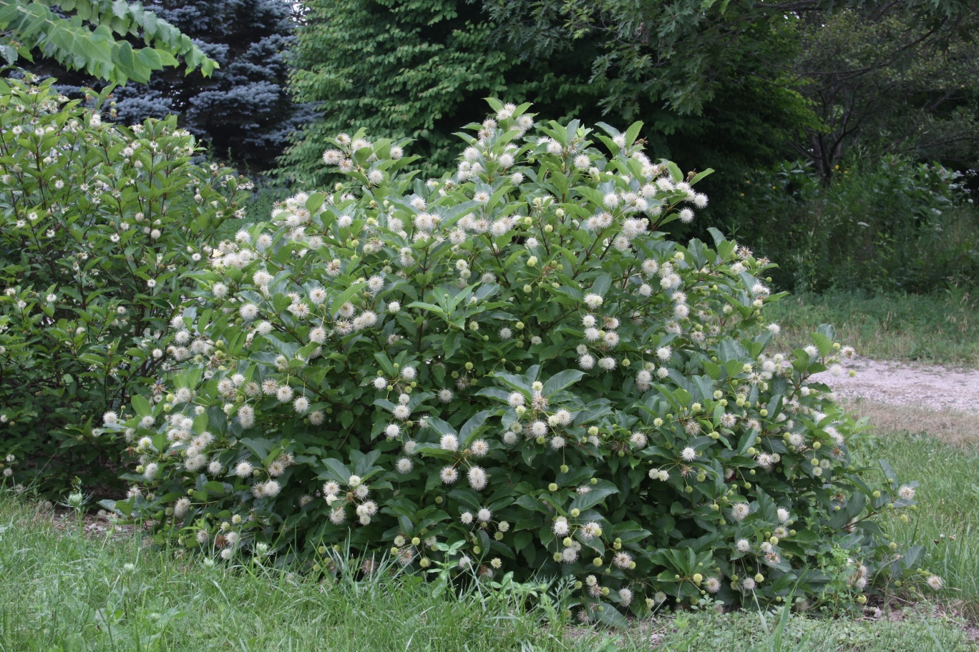
Notes:
These are some native shrubs that grow well in wetlands. As you see, they are attractive and provide berries for wildlife.

Slide 19
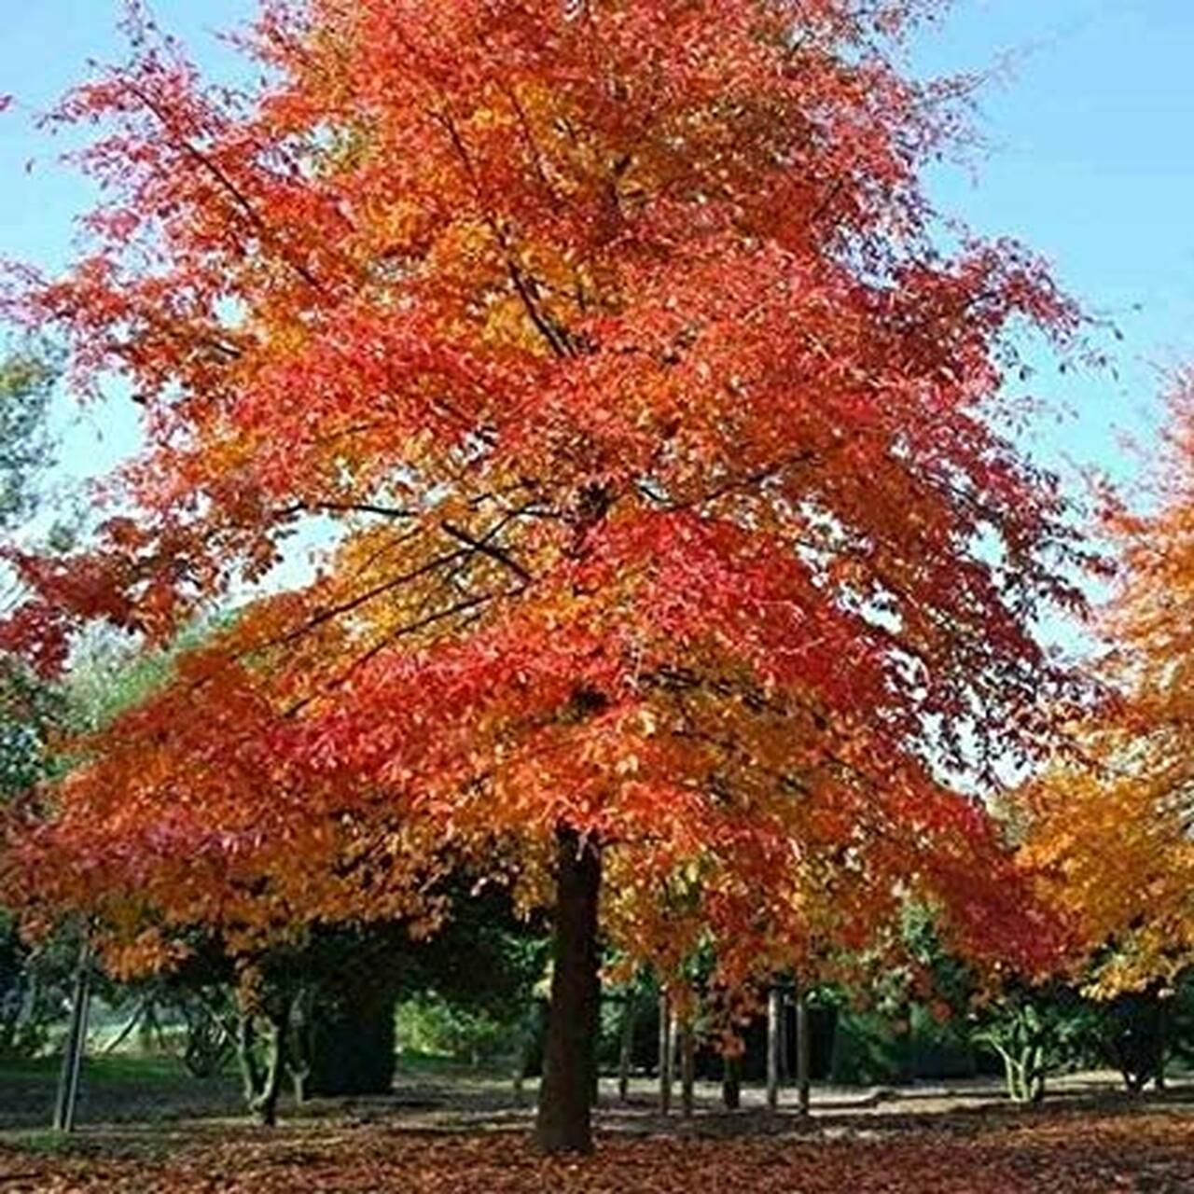
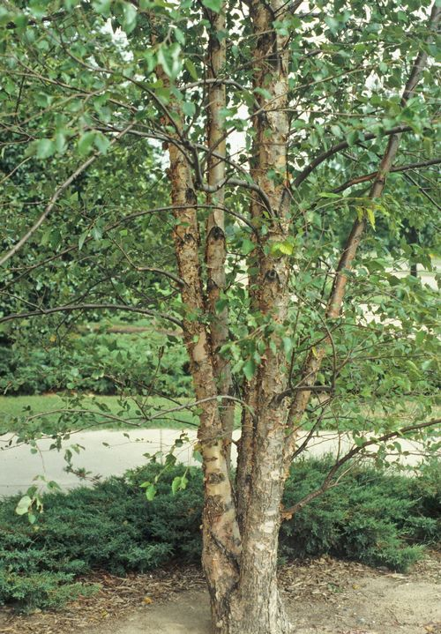
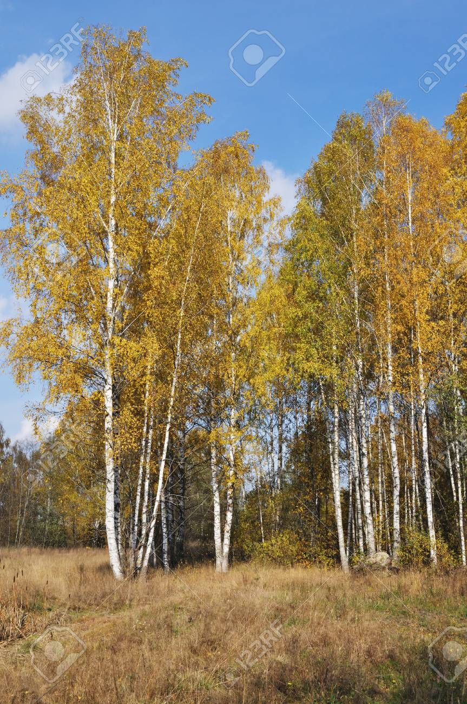
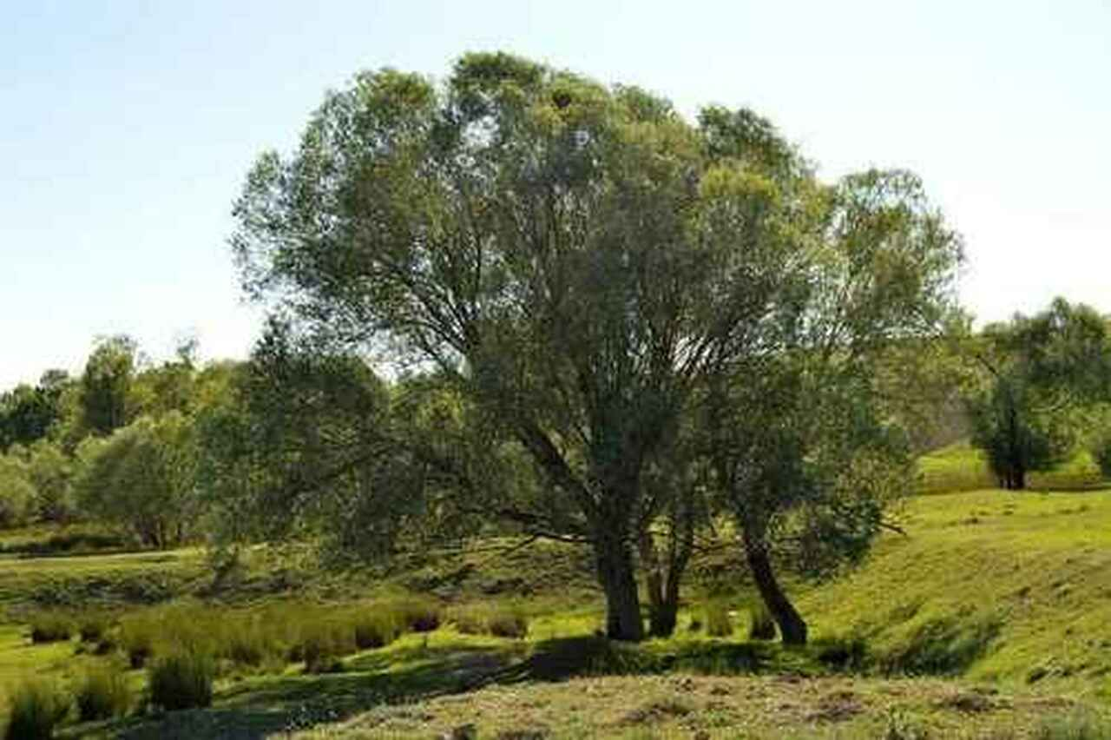
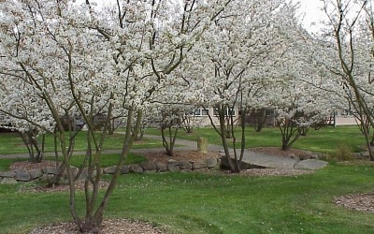
Black gum
River Birch
Yellow Birch
Black willow
Serviceberry
Notes:
Some trees that grow in wetlands and would be good for a riparian buffer

Slide 20
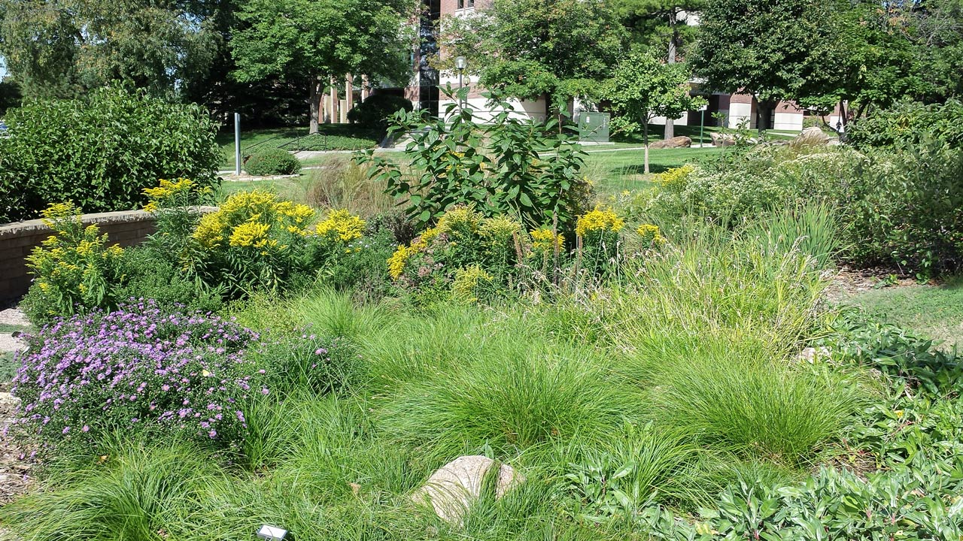
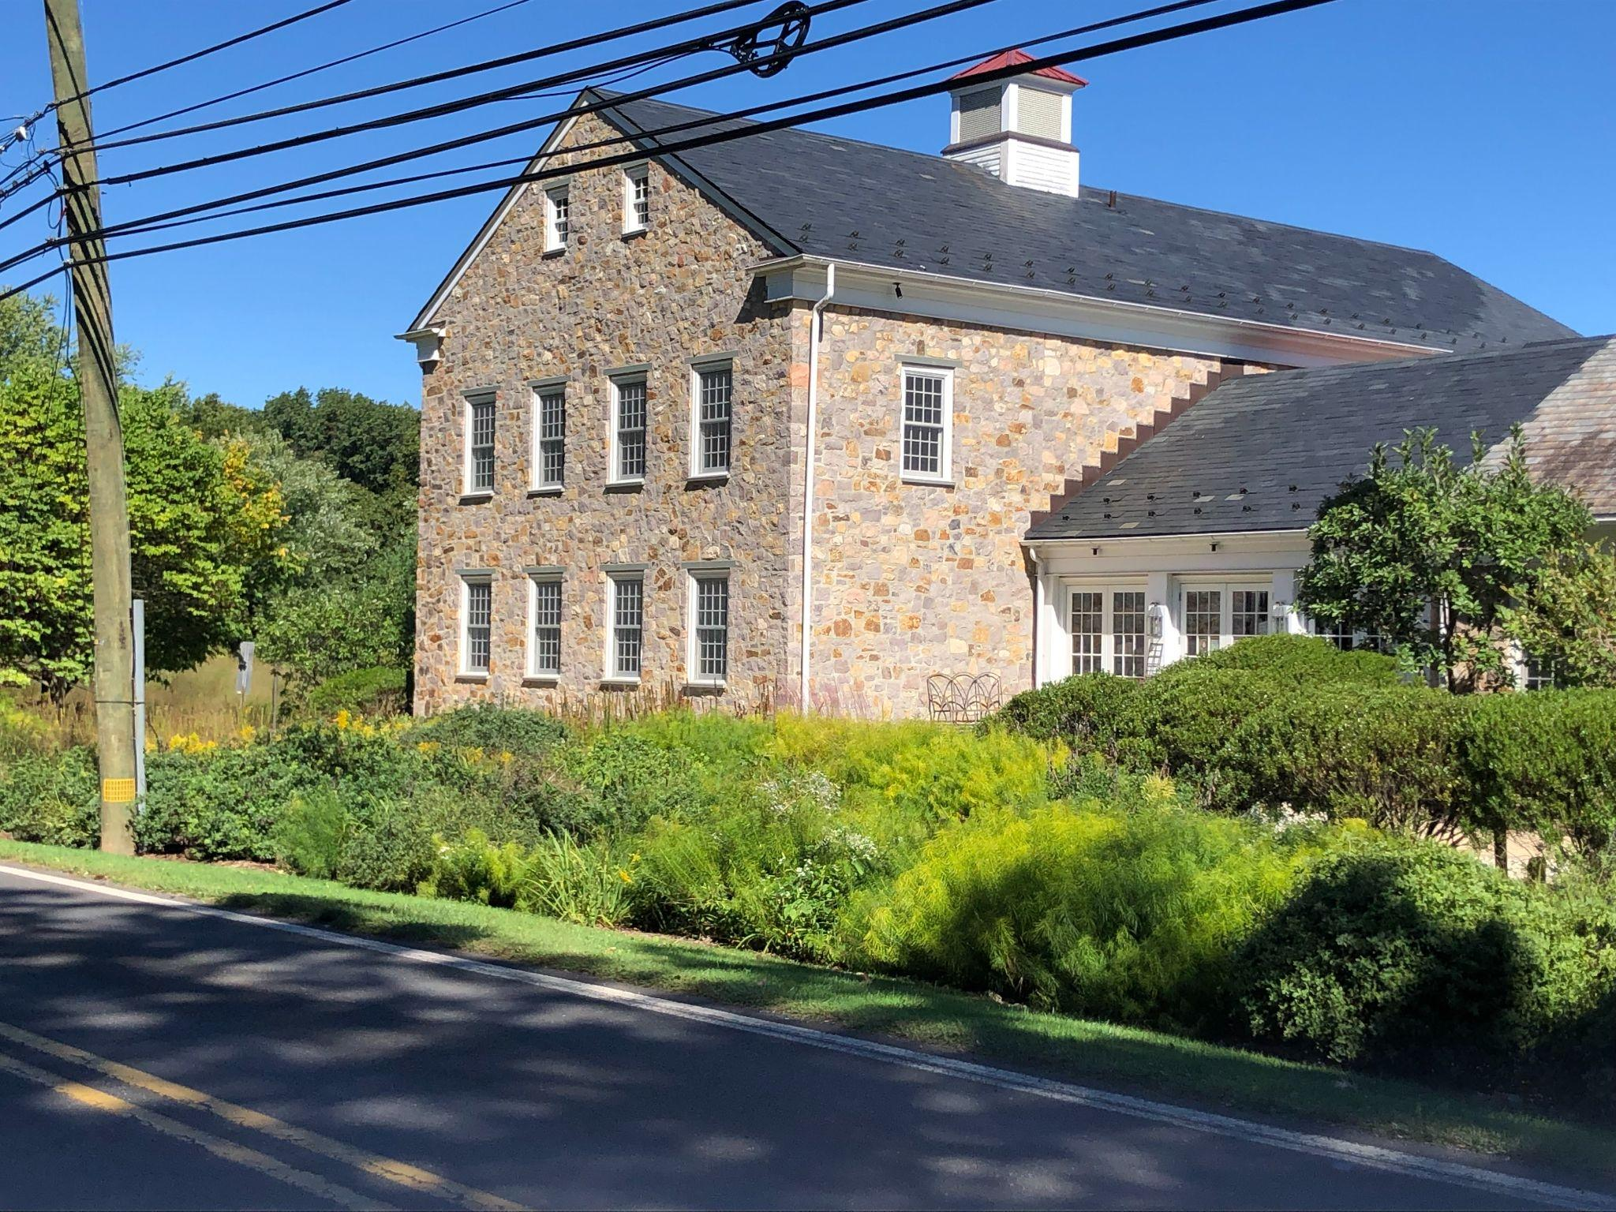
#5: Install rain gardens in flood prone areas
These plants are not just useful, they are beautiful as well!
(Image sources: http://justfunfacts.com/wp-content/uploads/2020/03/meadow.jpg
https://cdn.vox-cdn.com/thumbor/TAVFj9LXLJ-PIPqL4tfnypgVatY=/0x0:2237x1438/1200x800/filters:focal(940x541:1296x897)/cdn.vox-cdn.com/uploads/chorus_image/image/65891559/2011_09_toh_w_gdn_892.0.jpg

Slide 21
Benefits of Rain Gardens
Reduce runoff and flooding
Filter pollutants in stormwater runoff
Improve water infiltration and regeneration of ground water
Are low tech, inexpensive, easy to implement, and sustainable
Create habitats for wildlife and pollinating insects
Improve air quality and sequesters carbon
Reduce mosquito breeding
Look great and are environmentally friendly!!!

Slide 22
Community Event: Friday April 8 - 1:45-3:30
Install a rain garden
Plant a riparian buffer along the Primrose Creek
Repair planting beds, do spring clean up, mulch and plant cold weather plants in the vegetable gardens
Build beehives
Plant perennial plants in beds around campus
Wrap trees and shrubs and construct fences to protect from deer
Trail maintenance
Remove invasive plants and support native plants along the Primrose Creek
Split wood
Watch a video on climate change

Slide 23
Community Event: Friday, April 8 - 1:45-3:30
Check the weather forecast and dress accordingly
Many of the activities will be in muddy areas - wear appropriate footwear (boots are a good idea) and possibly a change of pants or shoes
Bring work gloves if you have them
You might want to wear a hat and/or sunscreen and insect repellant
Come with a positive attitude. You are changing the world for the better!

Slide 24
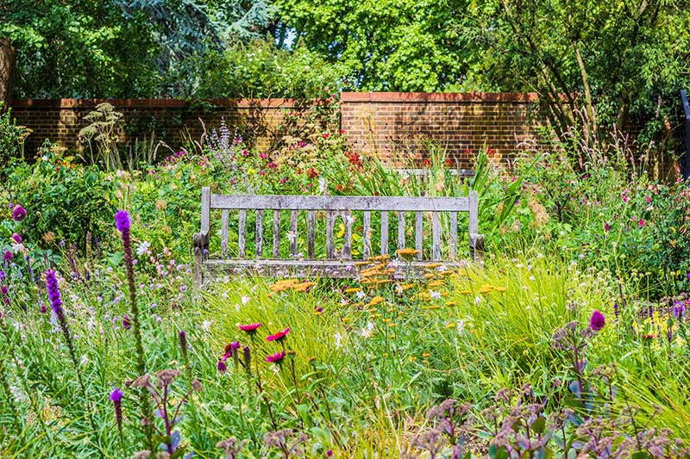
Educate Others
We hope you will feel proud of what we accomplish together tomorrow, and in the years to come, you will remember to sit and enjoy the beauty of our campus and the natural world in all its diversity.

